Slide 1

WINE QUALITY
WINE QUALITY
WINE QUALITY

Slide 2

OUR TEAM
WINE QUALITY
WINE QUALITY
WINE QUALITY

Slide 3
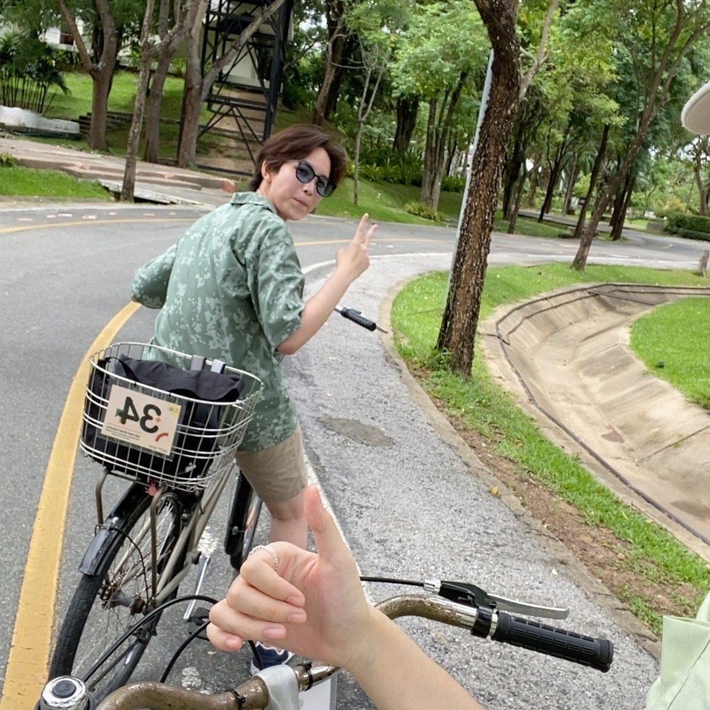


OUR TEAM
WINE QUALITY
WINE QUALITY
WINE QUALITY
KRITTAYA CHIMBUNYOO
650510653
PRAKIT
BUATHONG
650510669
WORADA
SAJAI
650510679

Slide 4



DATA
SET
CLEAN
DATA
VISUALIZE
CONCLUSION

Slide 5

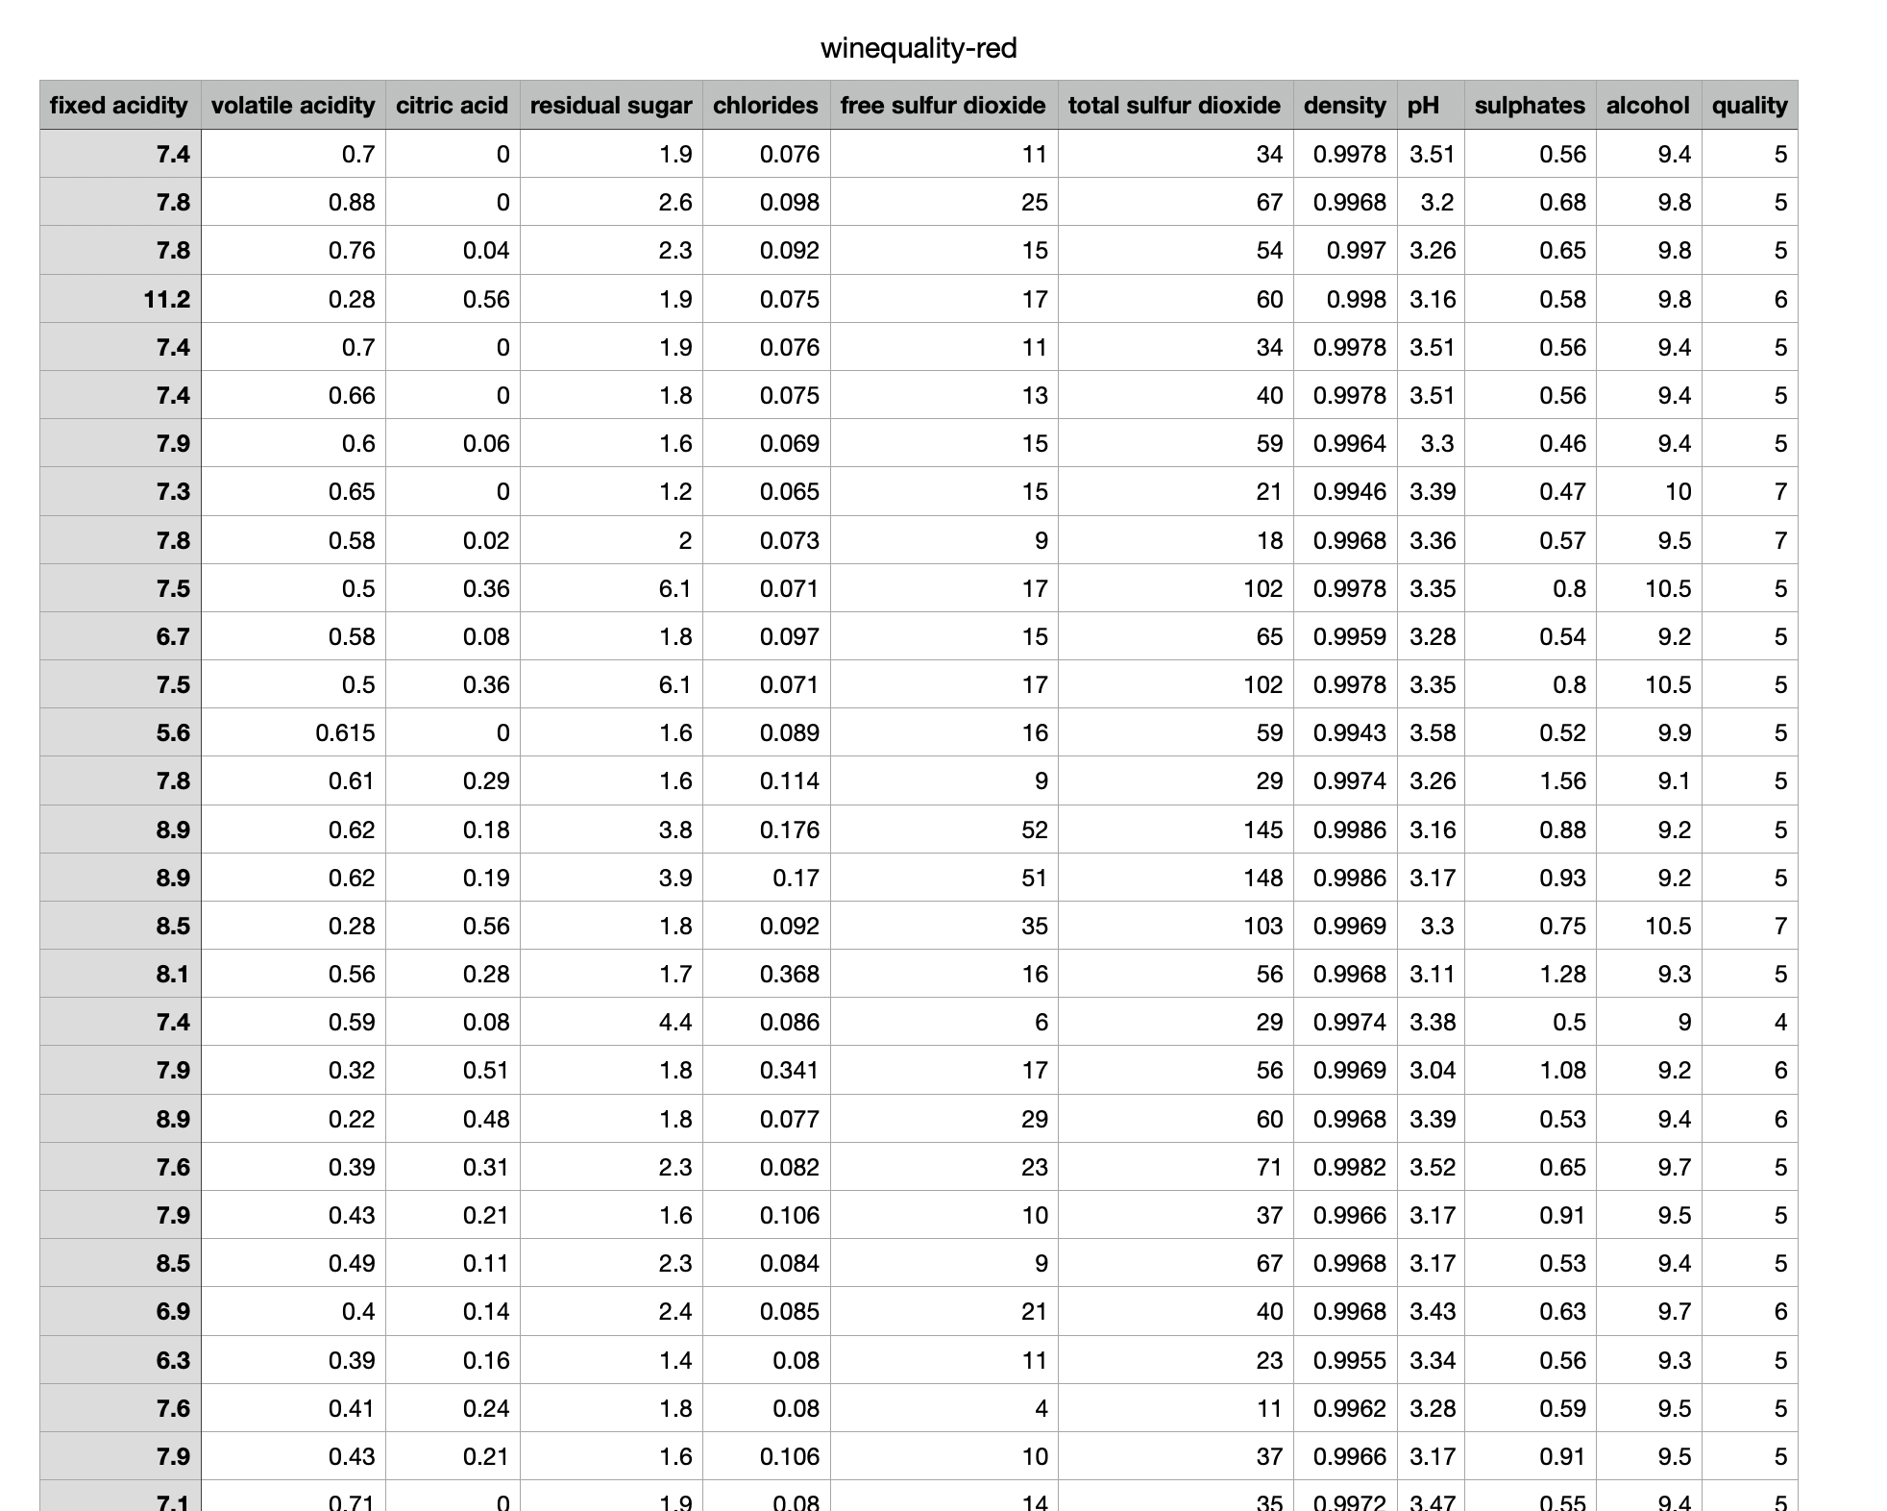


CLEAN
DATA
DATA
SET
ที่มาภาพ : https://www.kaggle.com/datasets/joebeachcapital/wine-quality?select=winequality-white.csv
VISUALIZE
CONCLUSION

Slide 6
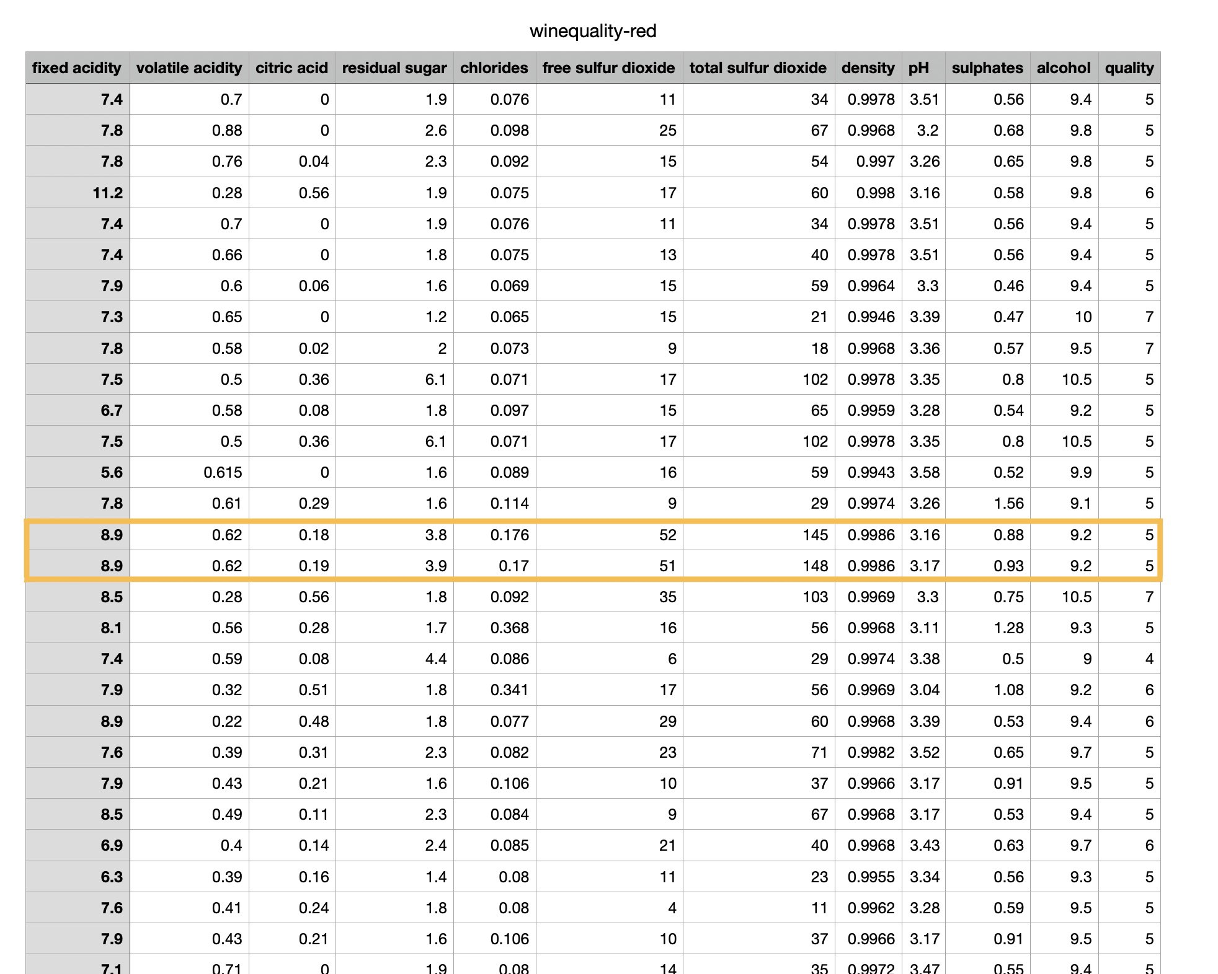
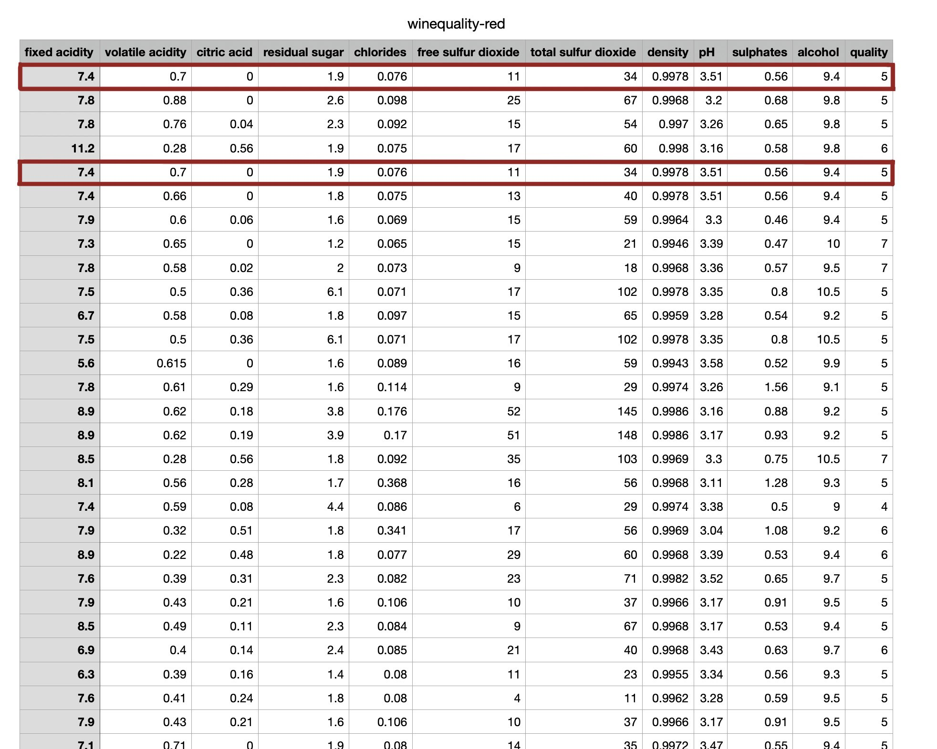
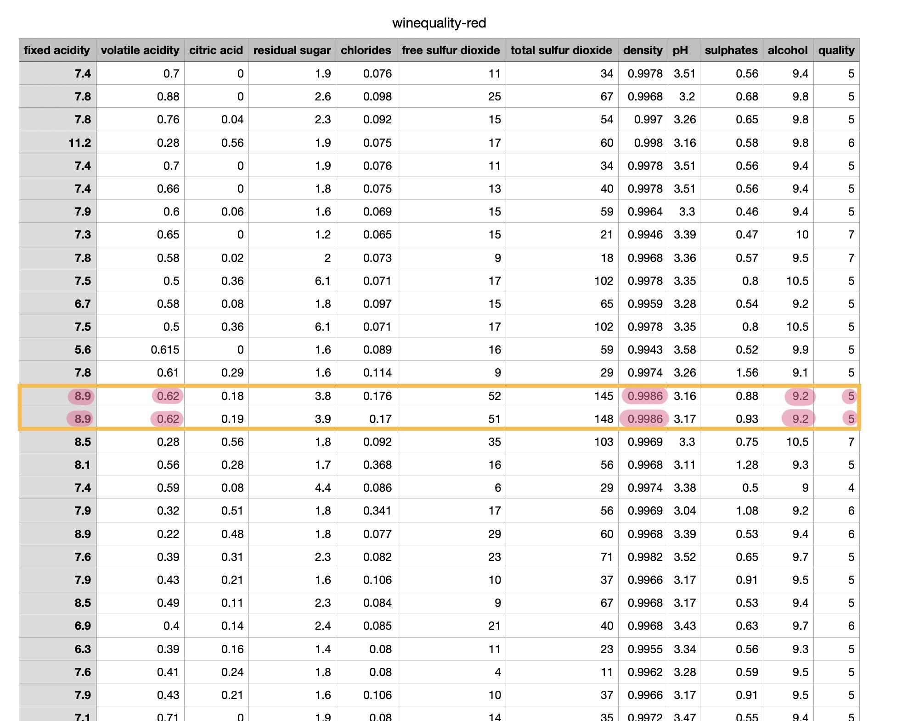
1. Duplicate Value
CLEAN
DATA
DATA
SET
VISUALIZE
VISUALIZE
CONCLUSION

Slide 7
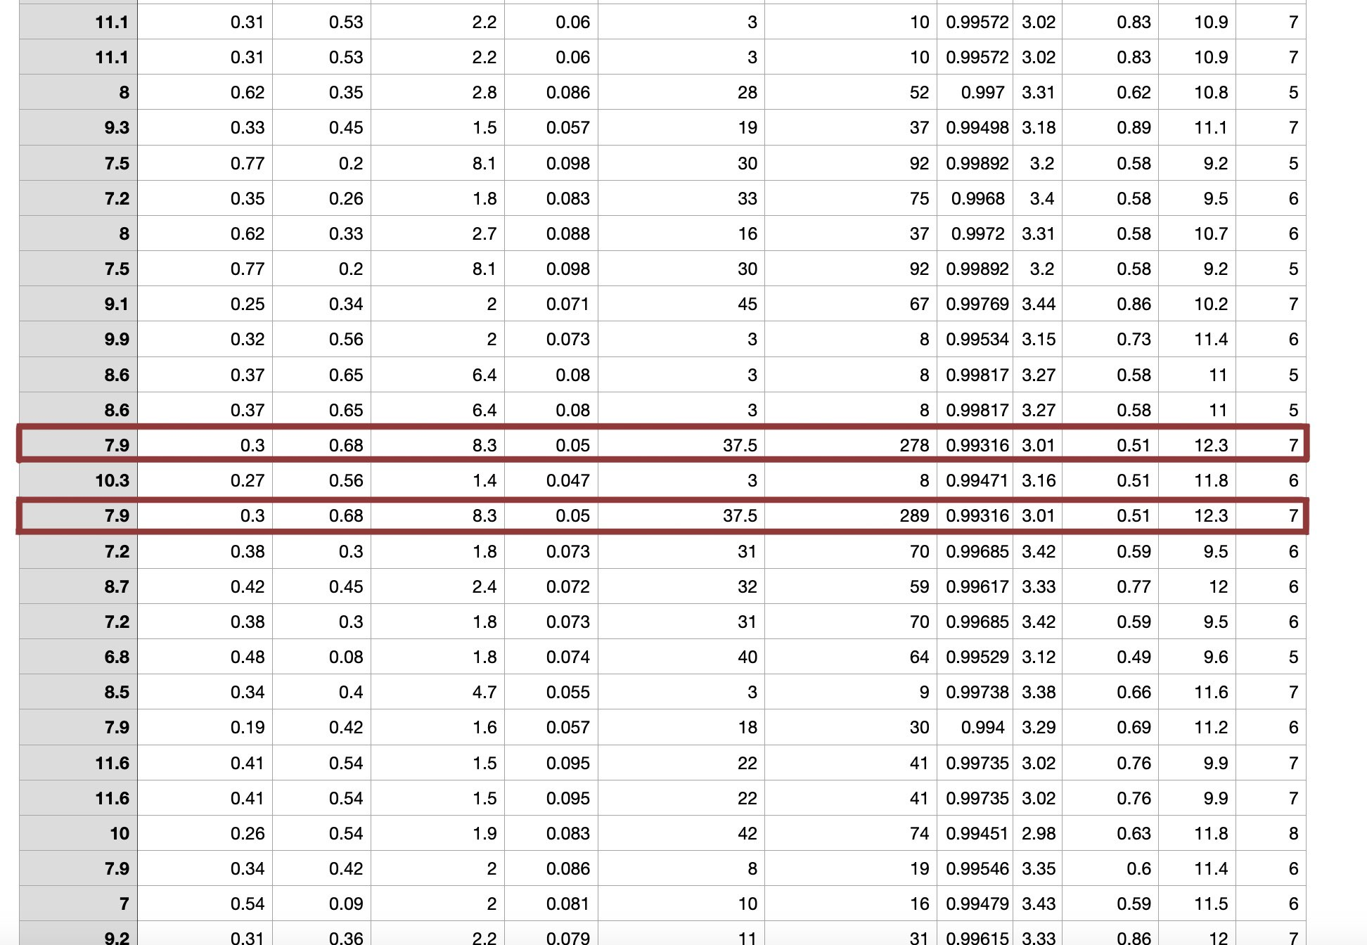
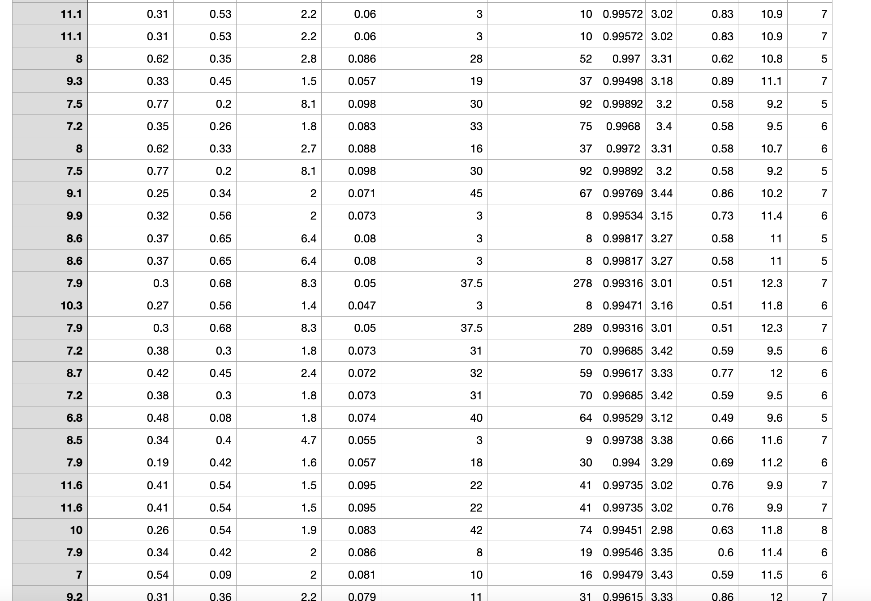
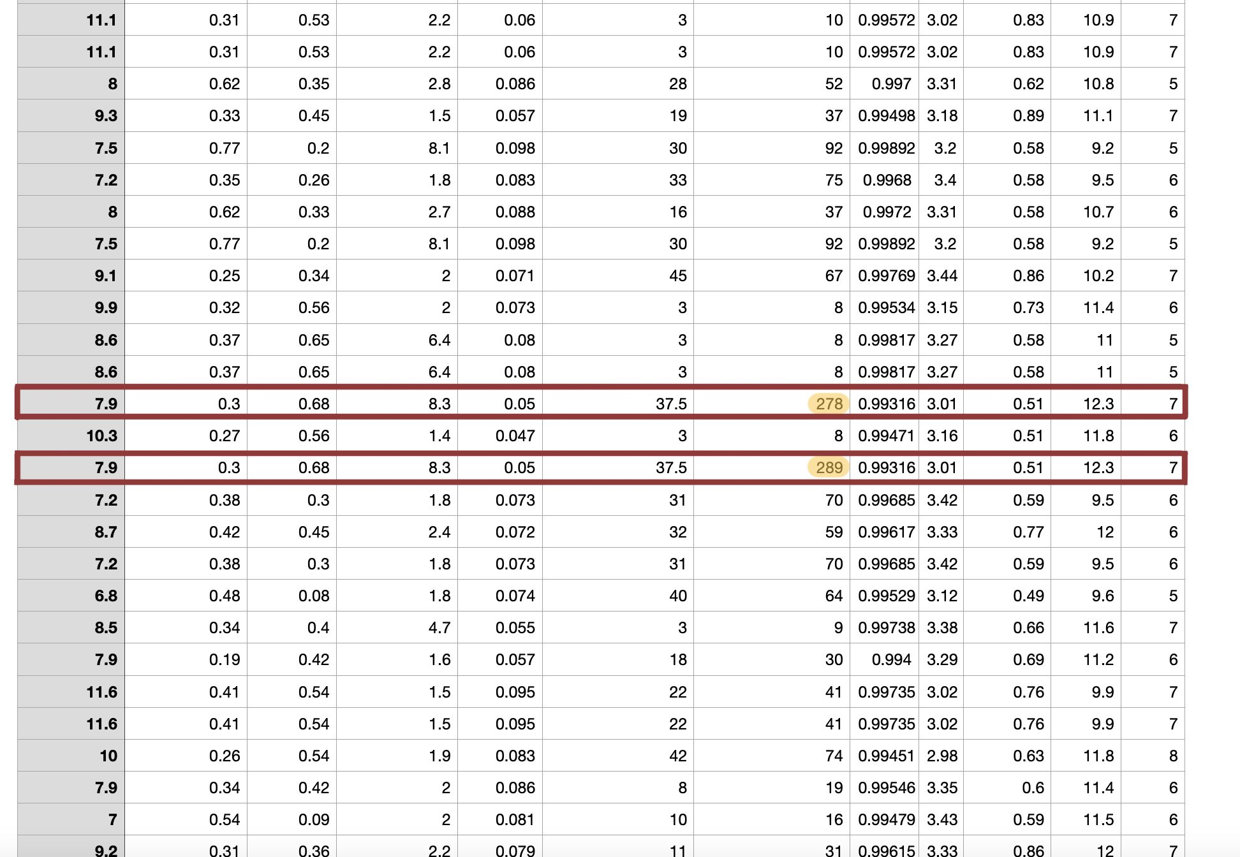
2.Outlier Value
CLEAN
DATA
DATA
SET
VISUALIZE
VISUALIZE
CONCLUSION

Slide 8
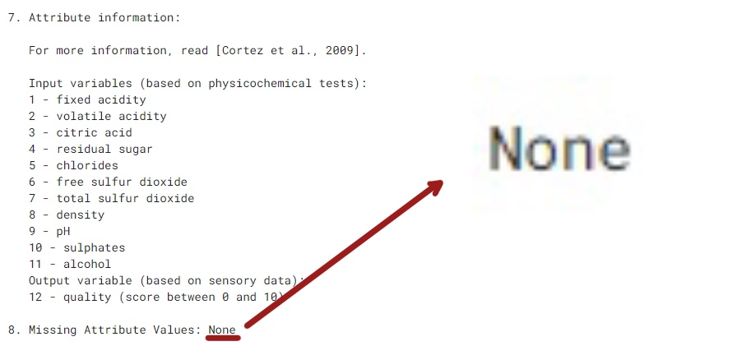
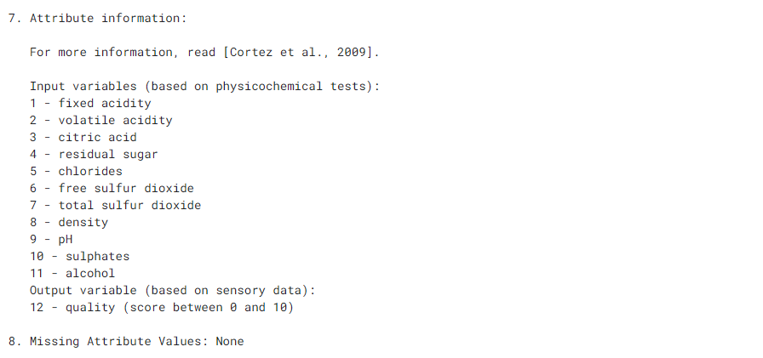
3.Missing Value
CLEAN
DATA
DATA
SET
VISUALIZE
VISUALIZE
CONCLUSION

Slide 9
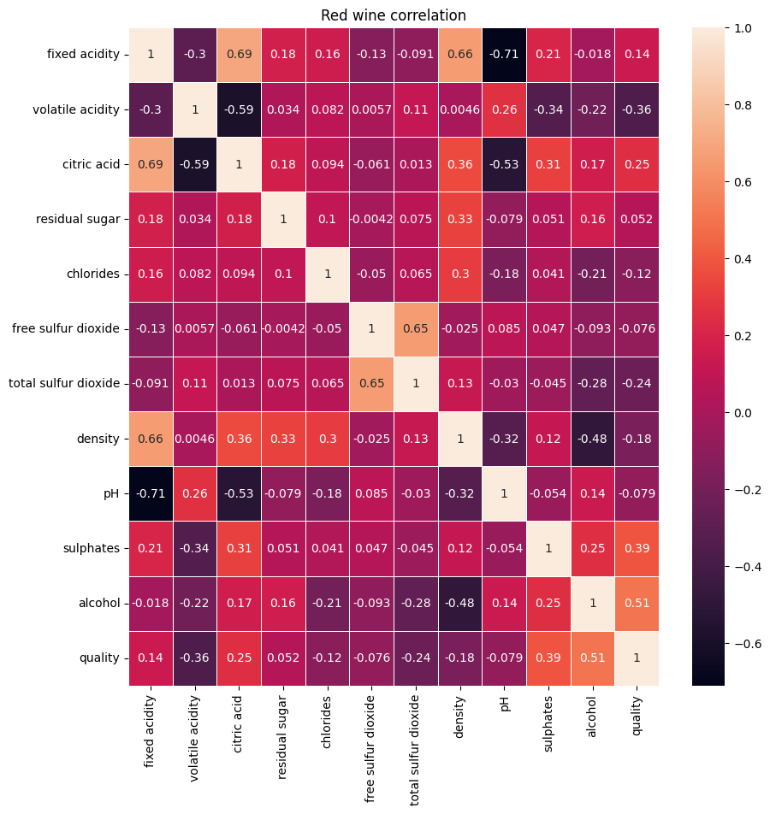
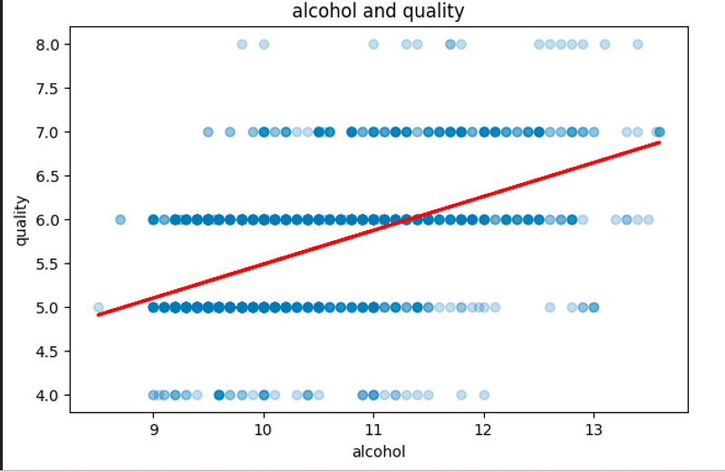
CLEAN
DATA
VISUALIZE
DATA
SET
VISUALIZE
CONCLUSION

Slide 10
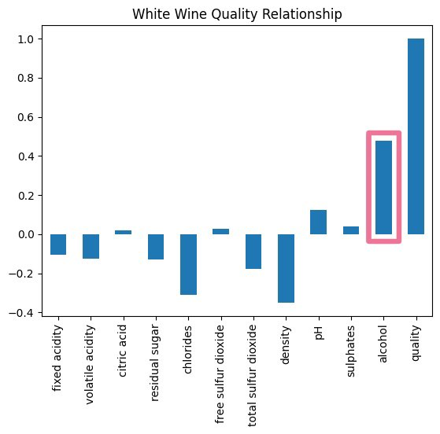
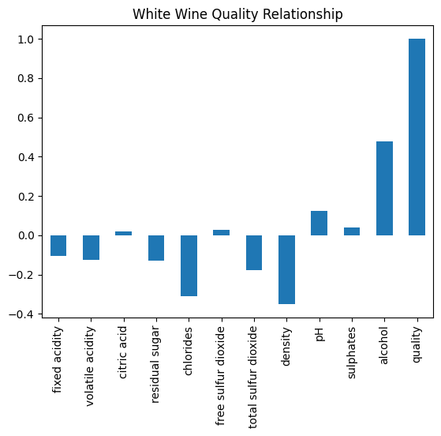
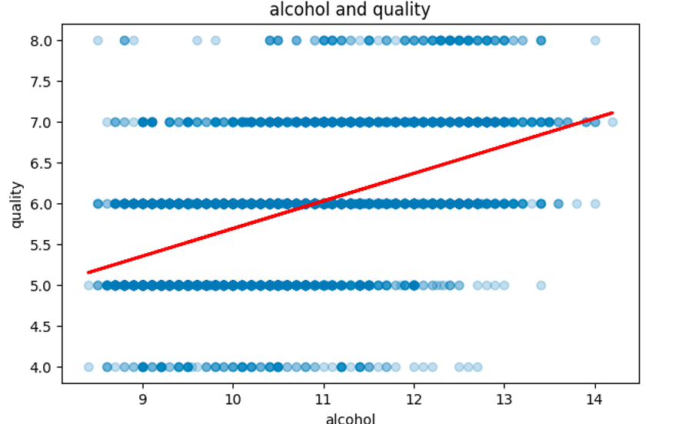
CLEAN
DATA
DATA
SET
VISUALIZE
CONCLUSION

Slide 11
CLEAN
DATA
DATA
SET
VISUALIZE
CONCLUSION

Slide 12

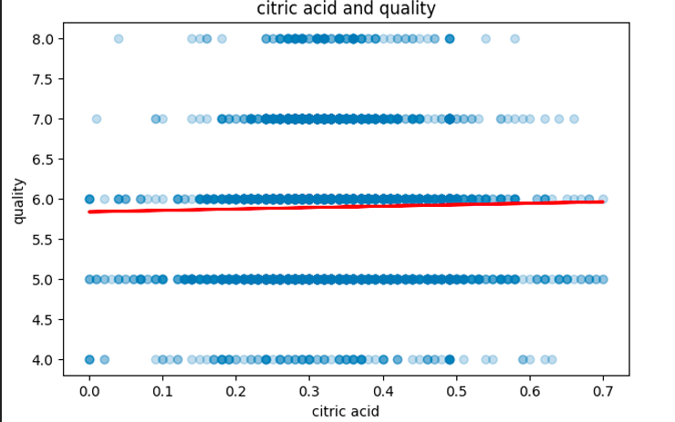
CLEAN
DATA
DATA
SET
VISUALIZE
CONCLUSION

Slide 13
CLEAN
DATA
DATA
SET
VISUALIZE
CONCLUSION

Slide 14
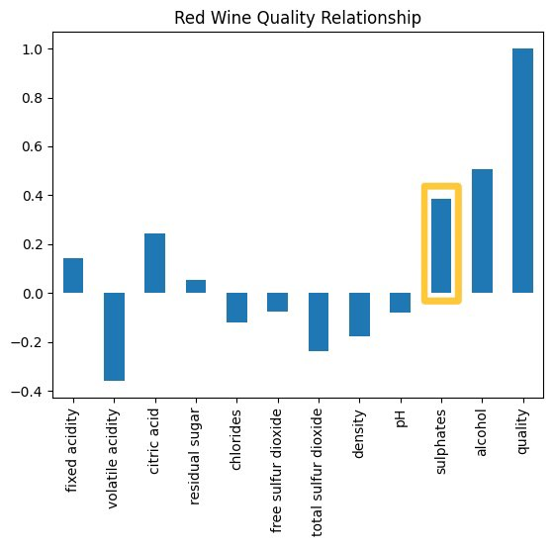
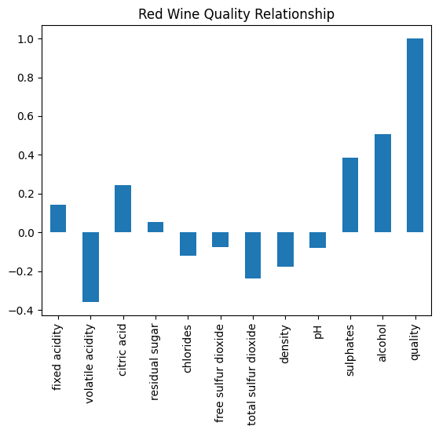
CLEAN
DATA
DATA
SET
VISUALIZE
CONCLUSION

Slide 15
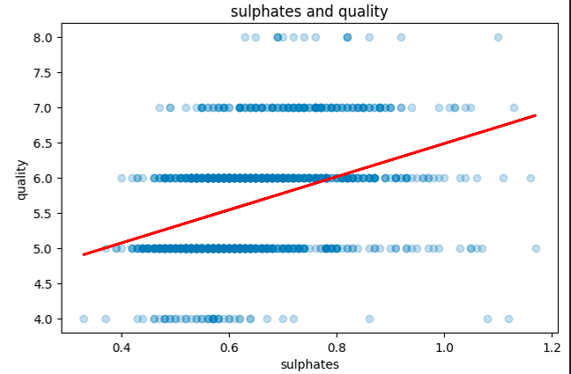
CLEAN
DATA
DATA
SET
VISUALIZE
CONCLUSION

Slide 16
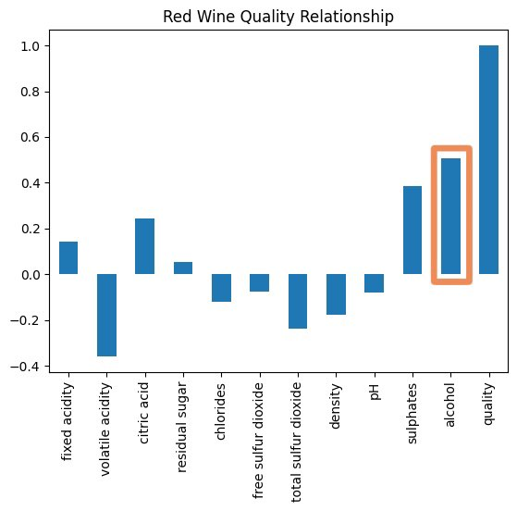
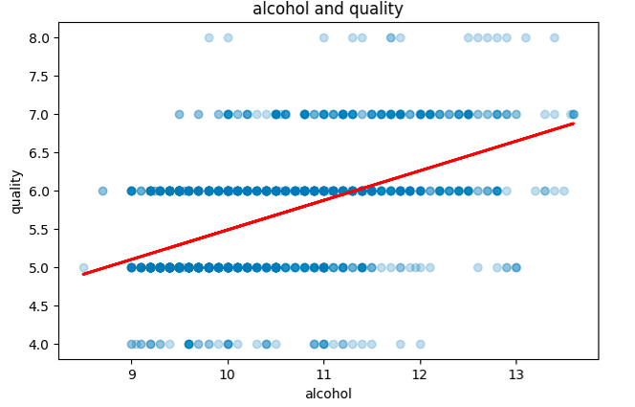
CLEAN
DATA
DATA
SET
VISUALIZE
CONCLUSION

Slide 17
CLEAN
DATA
DATA
SET
VISUALIZE
CONCLUSION

Slide 18

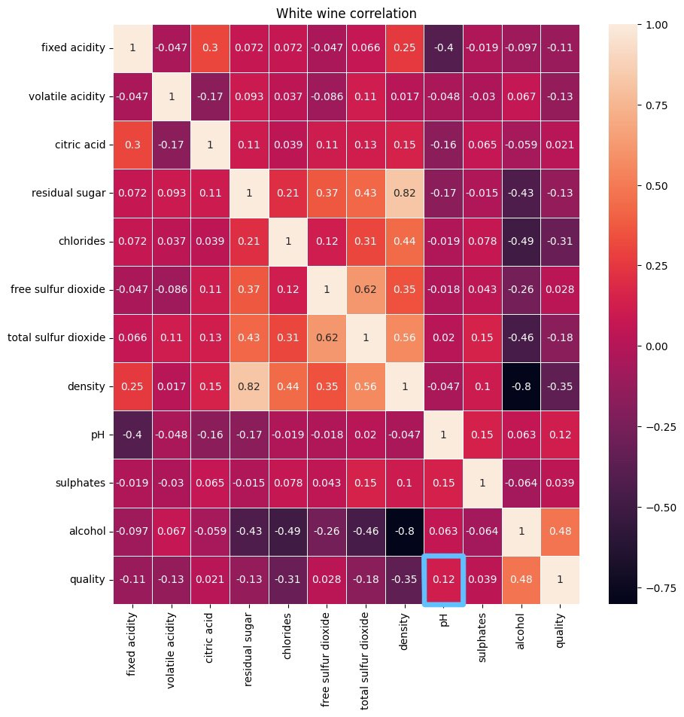

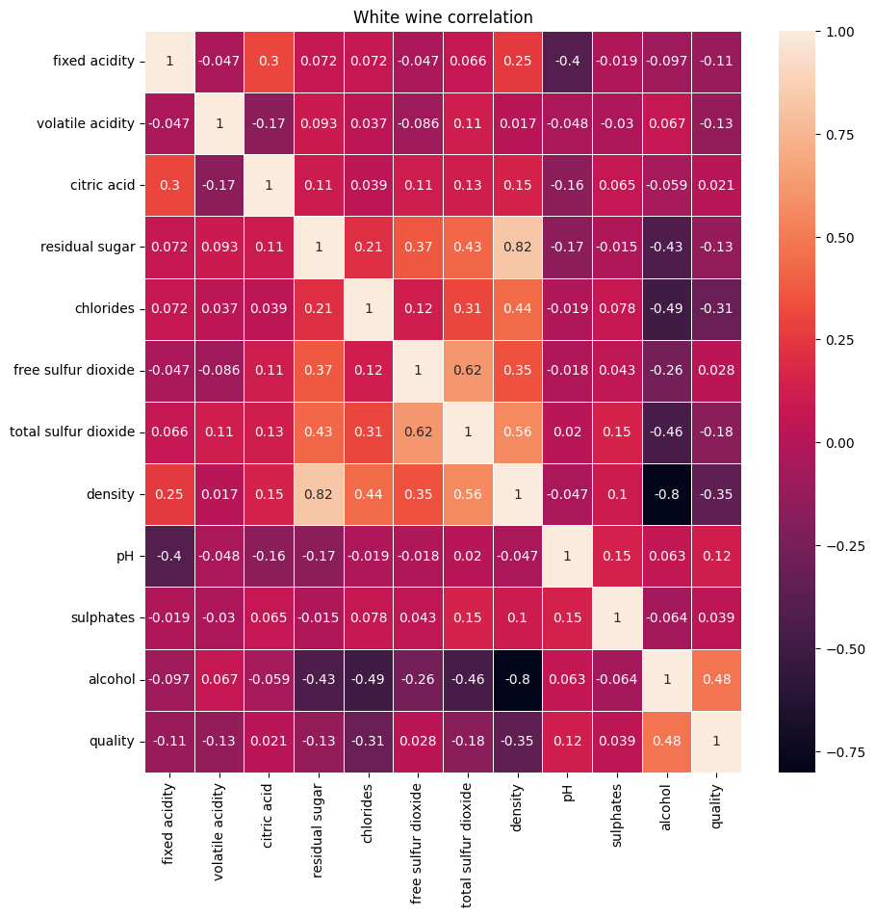
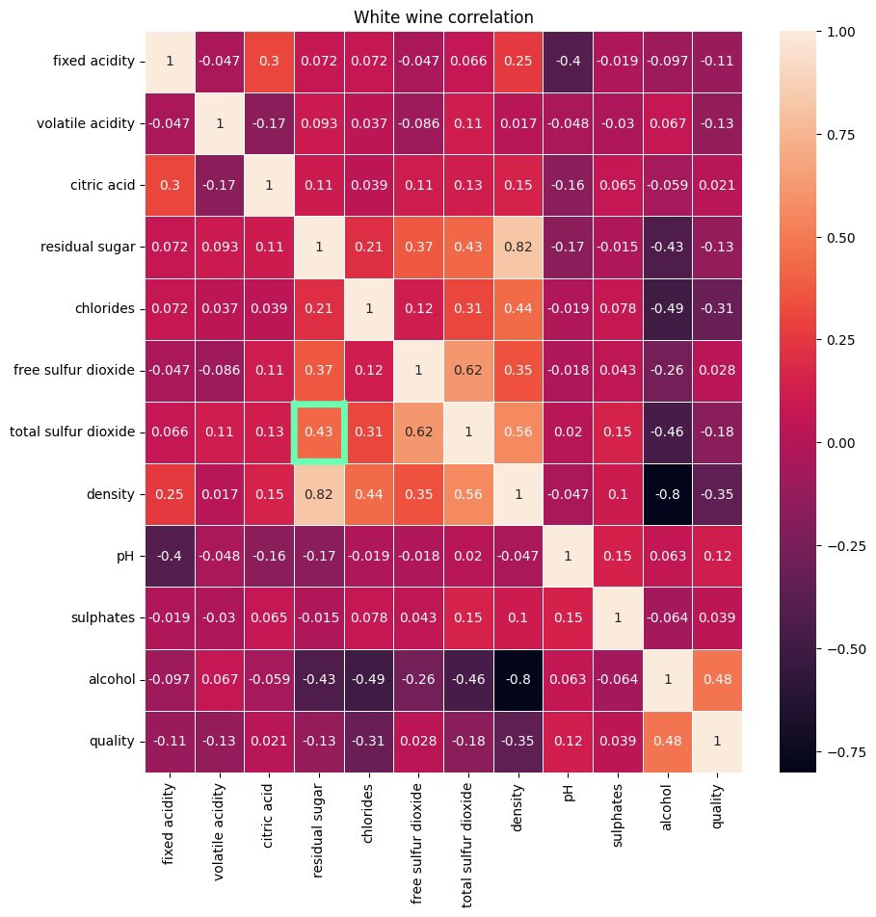
CLEAN
DATA
DATA
SET
VISUALIZE
CONCLUSION

Slide 19
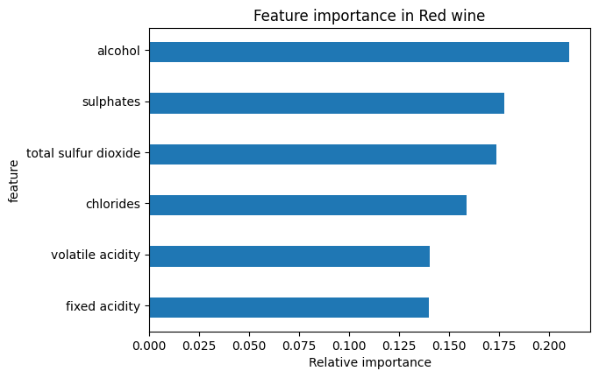
CLEAN
DATA
VISUALIZE
DATA
SET
CONCLUSION
VISUALIZE

